Slide 1
How to check schedules and results in the academic system

Slide 2
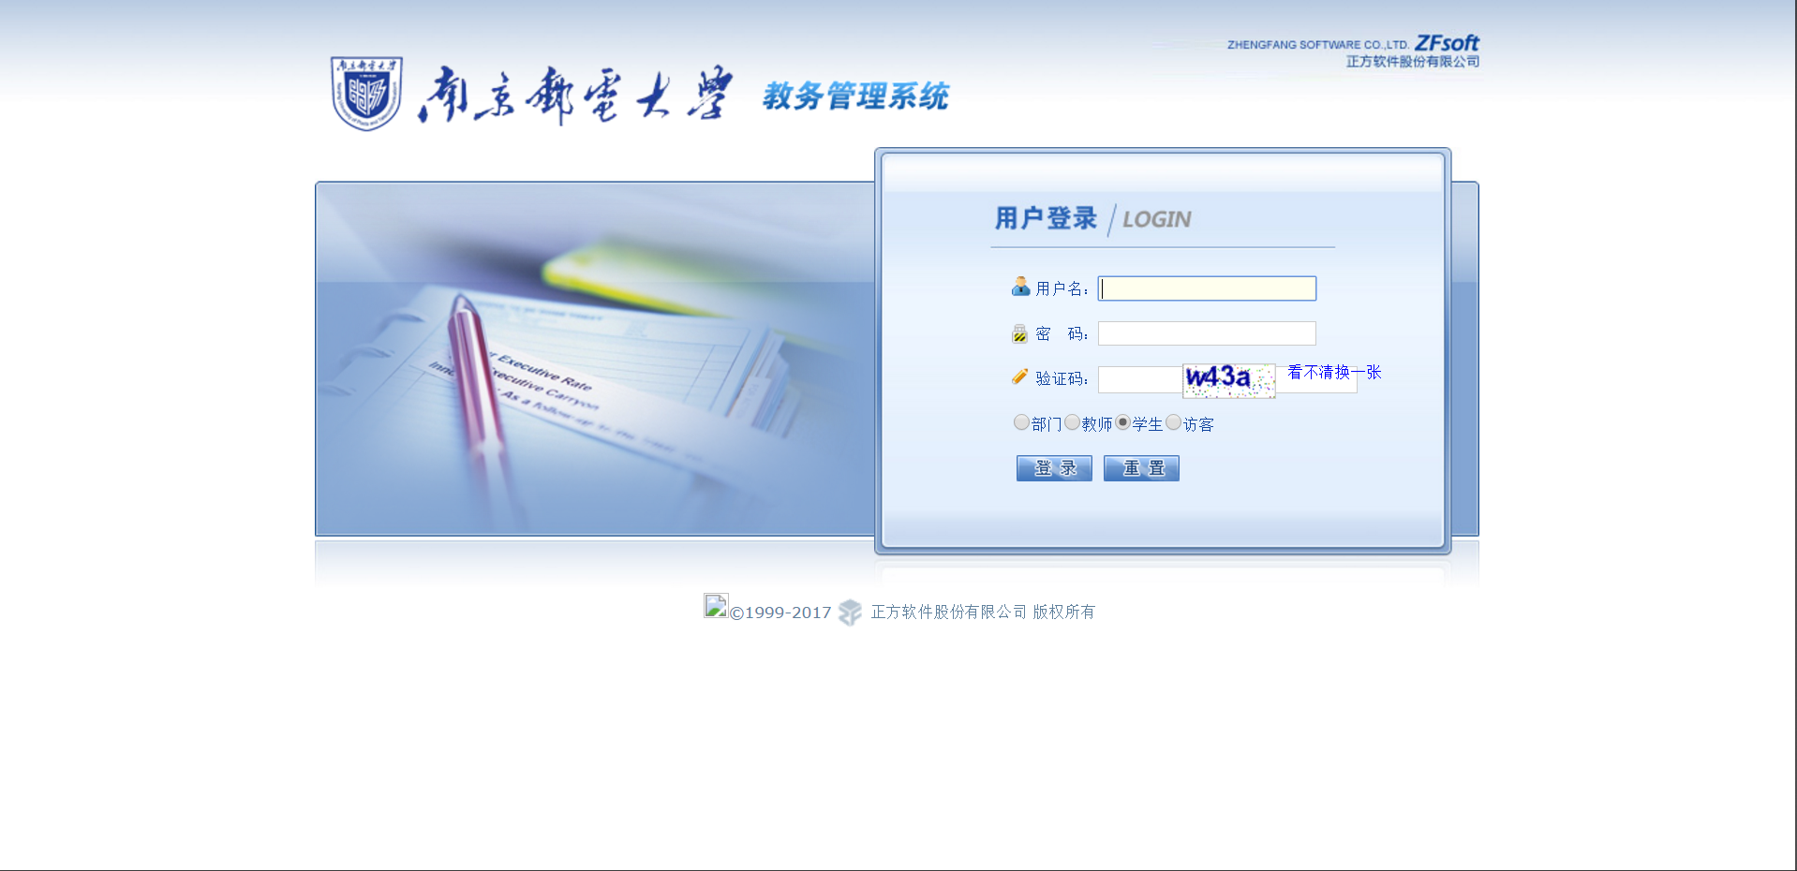
User’s ID
Password
Verification code
Method 1:via the official website: jwxt.njupt.edu.cn
login reset
Original password FOR 2019 BACH ：111111birthday1111
Birthday form example 19990911

Slide 3
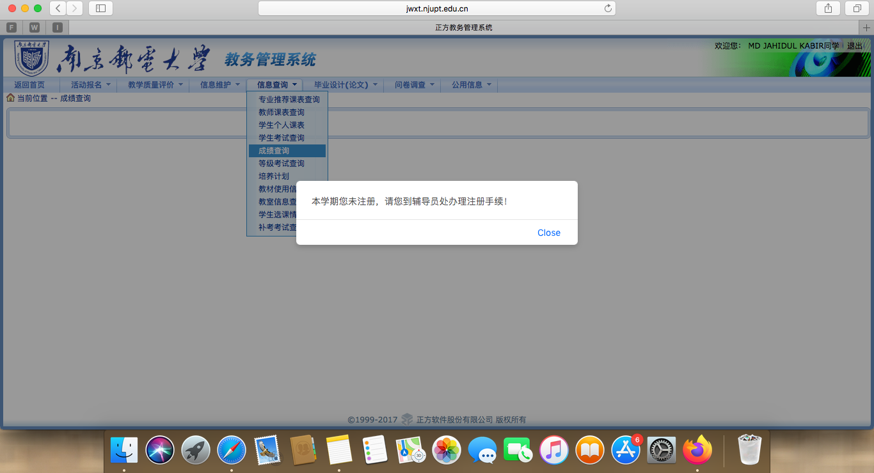
If you see this page, that means you need to go your advisor to register it, but you have to pay the tuition before register

Slide 4
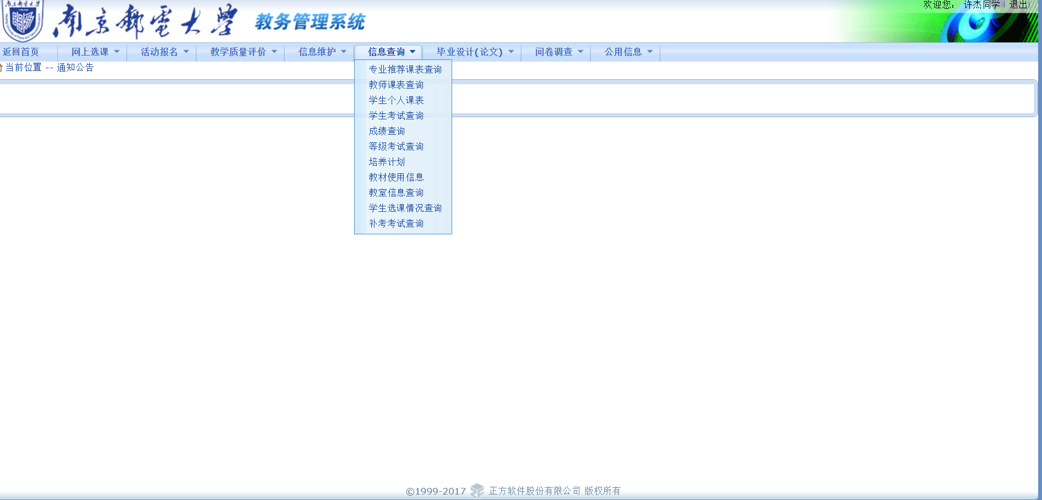
course schedules exam results

Slide 5
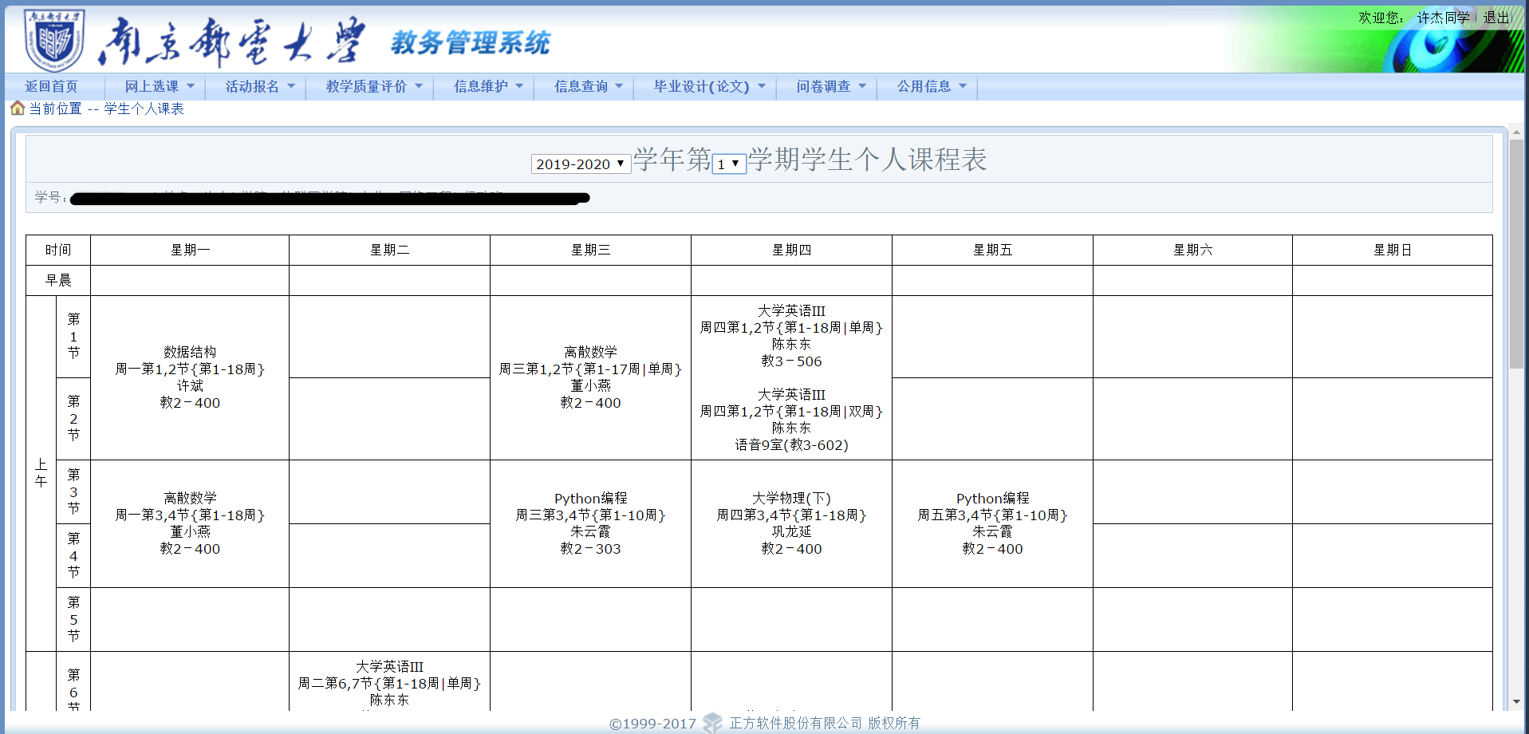
The academic year semester

Slide 6
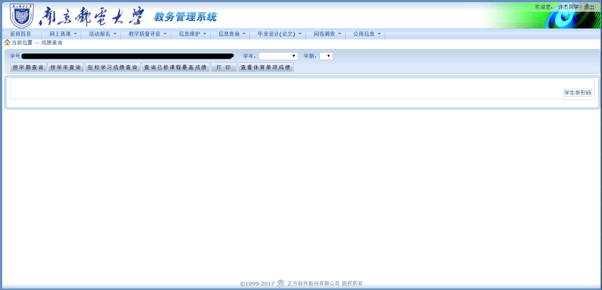
The academic year semester
By the semester
By the academic year
All results you have gained
Print the results

Slide 7
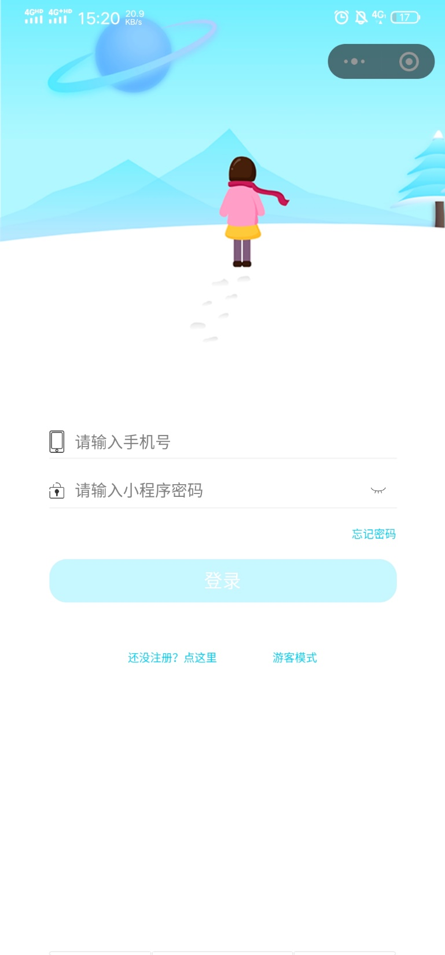
Method 2:via the wechat app（南邮小程序 ）
User’s ID(your phone number connected)
Password（you set by yourself）
Register : you need to connect your school ID with your phone number to login

Slide 8
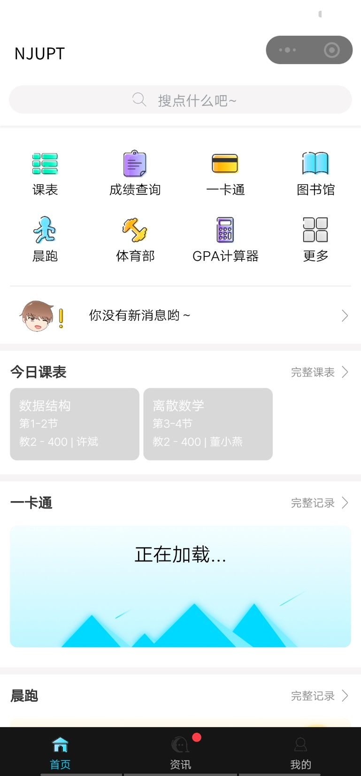
schedules results the query

Slide 9
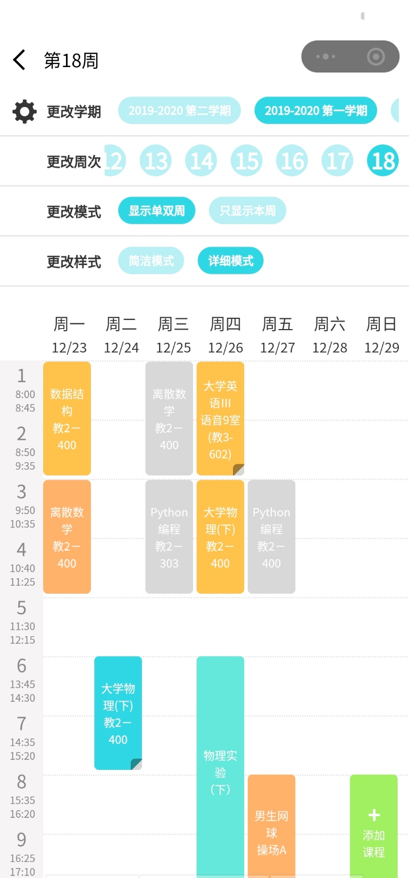
to change the semester
to change the week
to change the pattern
to change the style

Slide 10
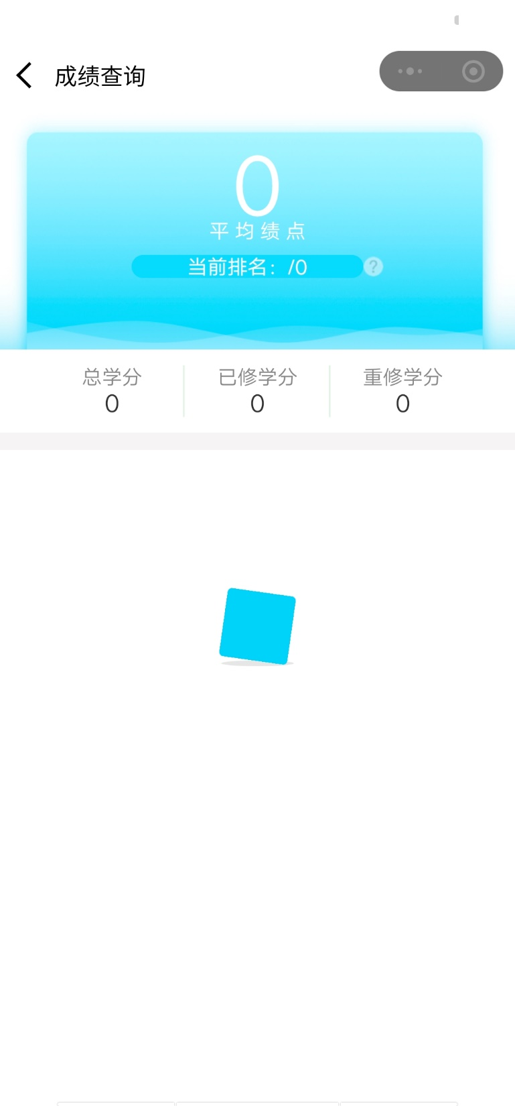
total credits the credits you
have gained
Details(haven’t been loaded yet)

Slide 11
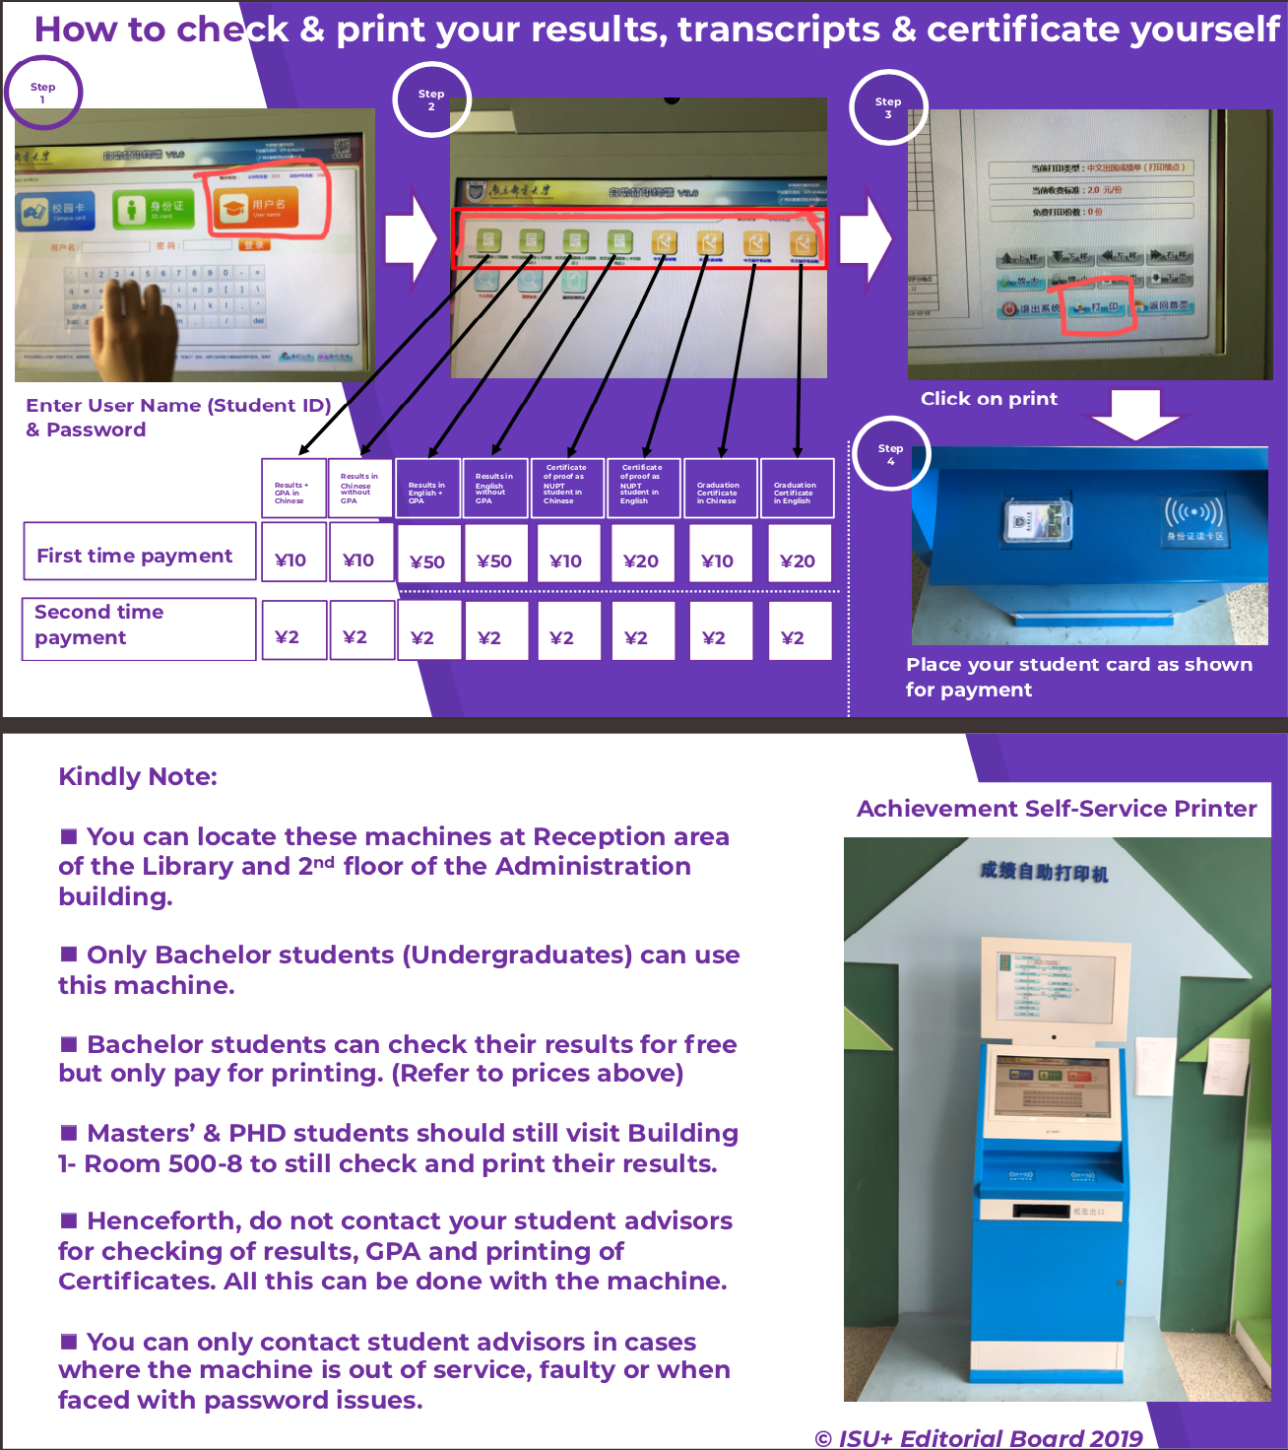
Method 3 go to automatic machine and check it

